Slide 1
Making the Connection:
The Duke Music Library Renovation
Laura Williams
SEMLA, October 20, 2012
Tuscaloosa, Alabama

Slide 2
Duke Music Library Renovation
August 2010 –August 2011: 1 year whirlwind process from planning to renovation to re-opening.
Enabled us to connect our two separate floors
Rare opportunity to completely reconfigure internal space to address overcrowding and lack of user spaces.

Slide 3
Renovation Process
Visual tour of the changes that were needed in the space
Factors that set the renovation process in motion
Themes that stood out in the renovation process for us:
  Advocacy and participation of Music Department in planning process
  Efforts to take full advantage of limited space to provide a variety of different zones for users and to make spaces multi-purpose
  Surprises that awaited renovation novices

Slide 4
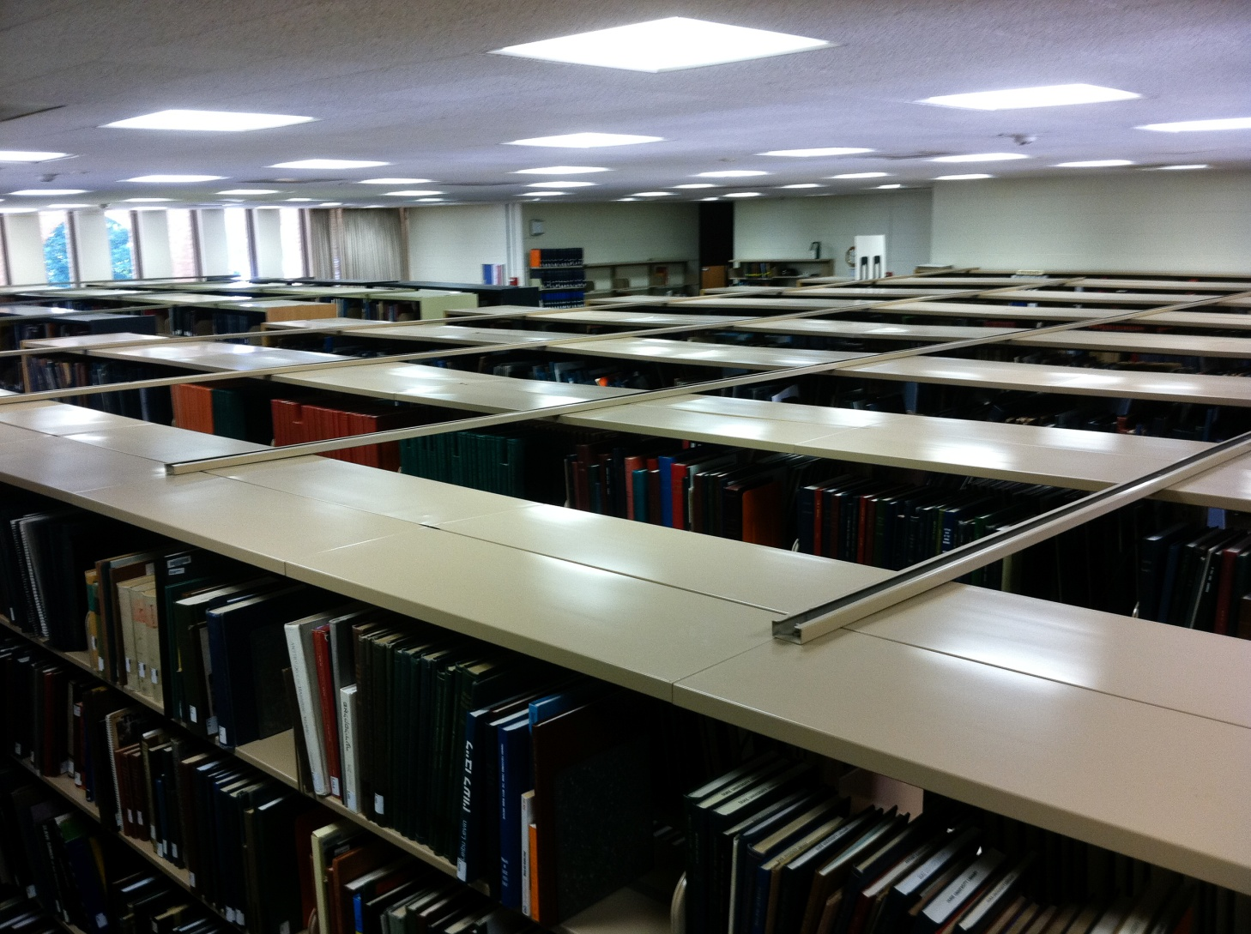
Overcrowded spaces

Slide 5
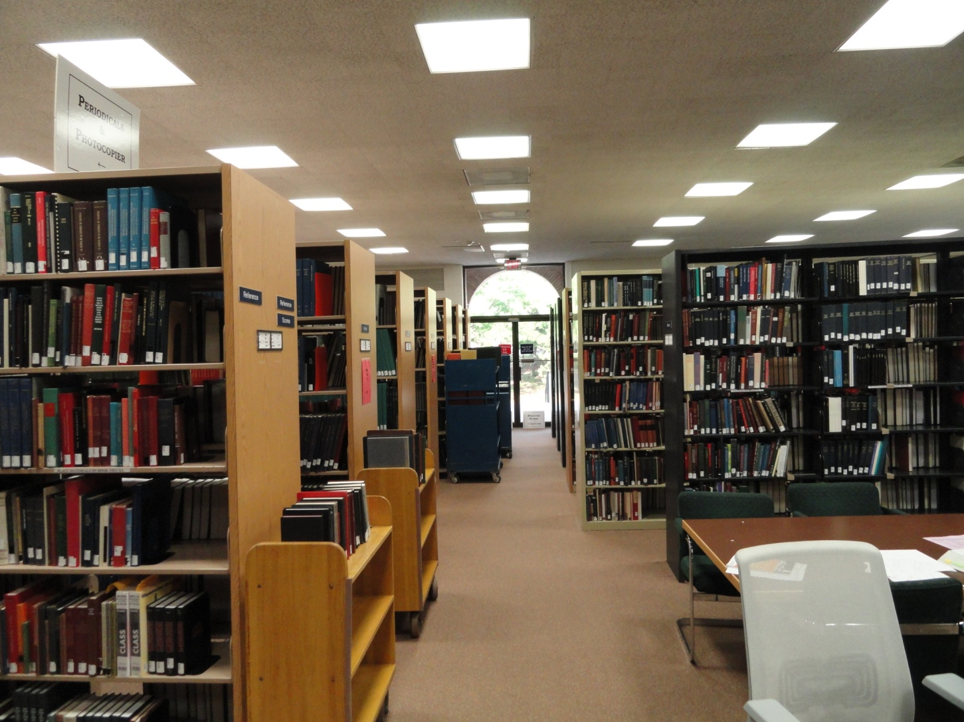
Layout of First Floor

Slide 6
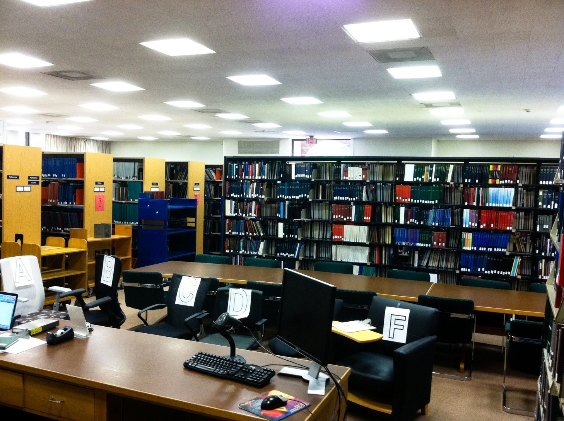
Minimal Study Areas
No spaces for interaction or group work

Slide 7
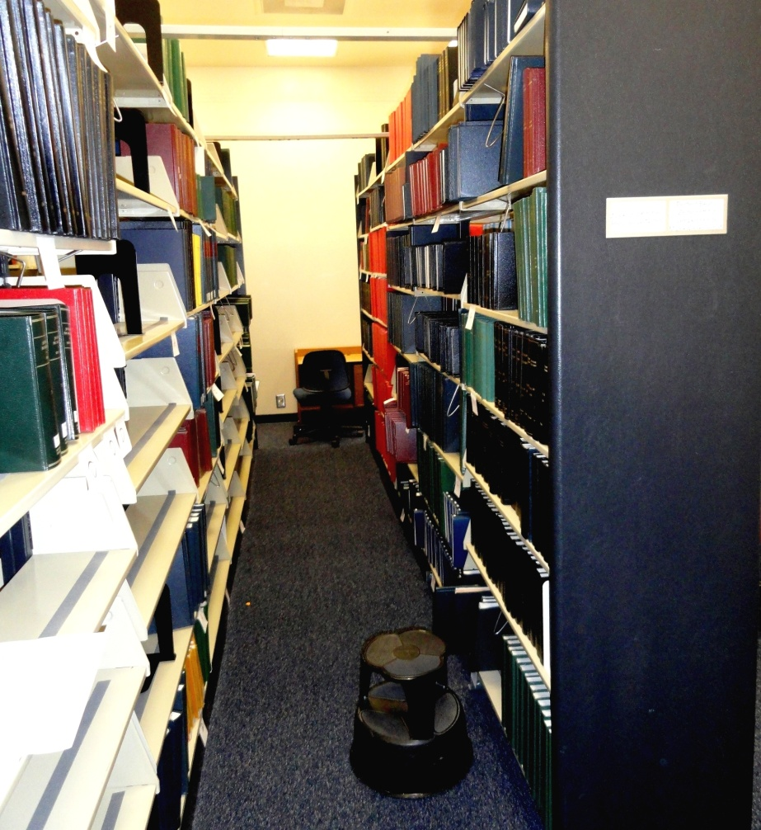
No Instructional Spaces:
Bound Periodicals Room Occupying Space originally designed as a Seminar Room

Slide 8
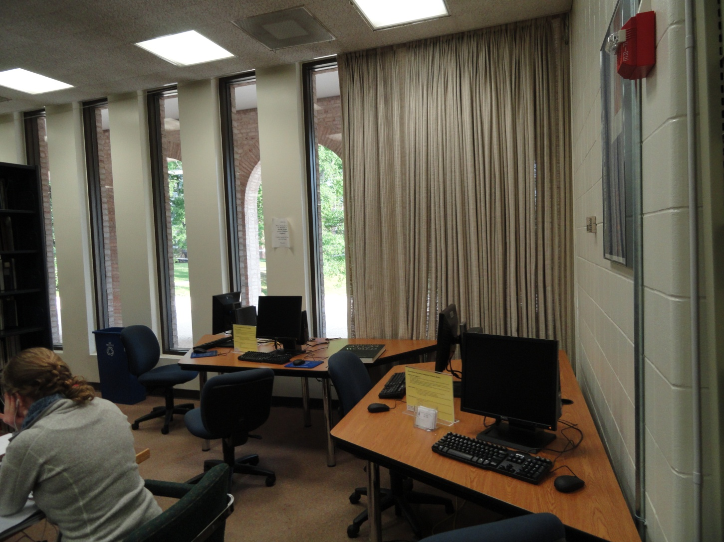
Spaces dark and cramped, despite floor-to-ceiling windows throughout space

Slide 9
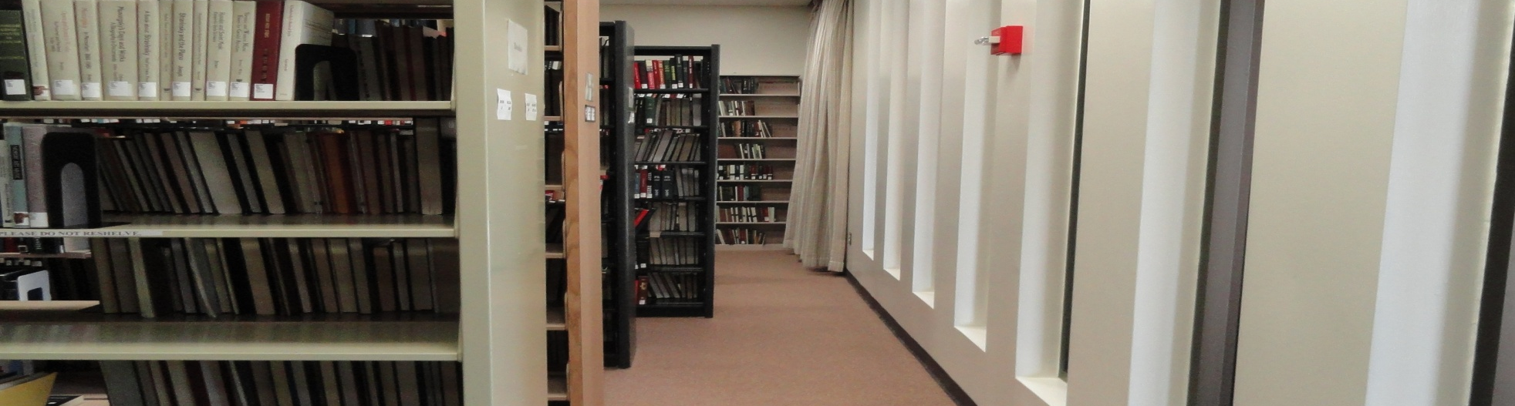
Insufficient shelving capacity—nearly half of collection in offsite storage
No connection between the two floors, with collection and services divided between print upstairs and media downstairs
Separate service desk on each floor with staffing spread thinly to cover each

Slide 10
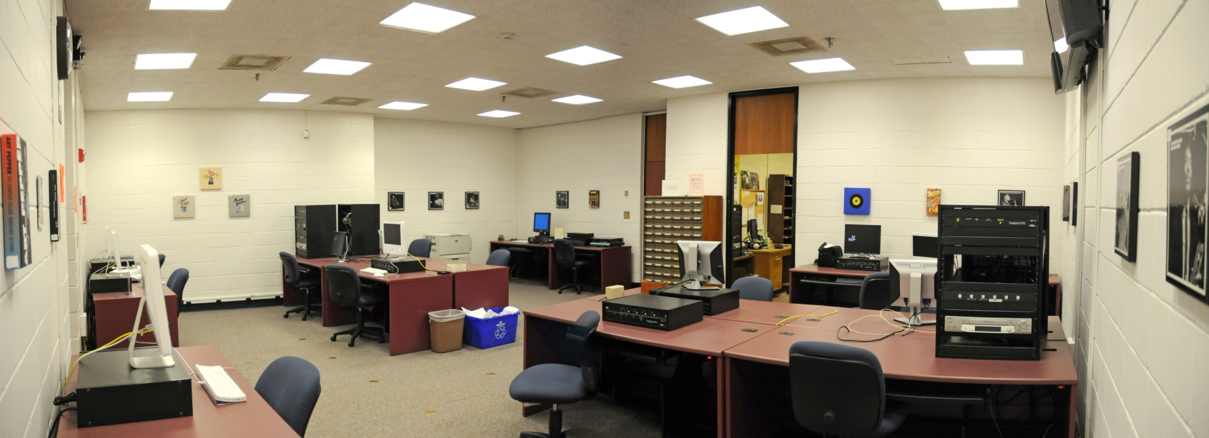
More spacious Music Media Center downstairs underutilized

Slide 11
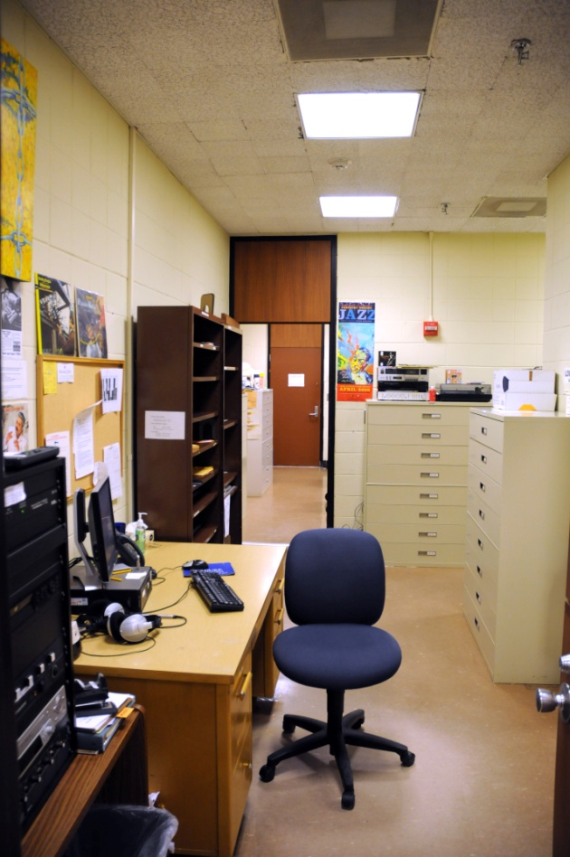
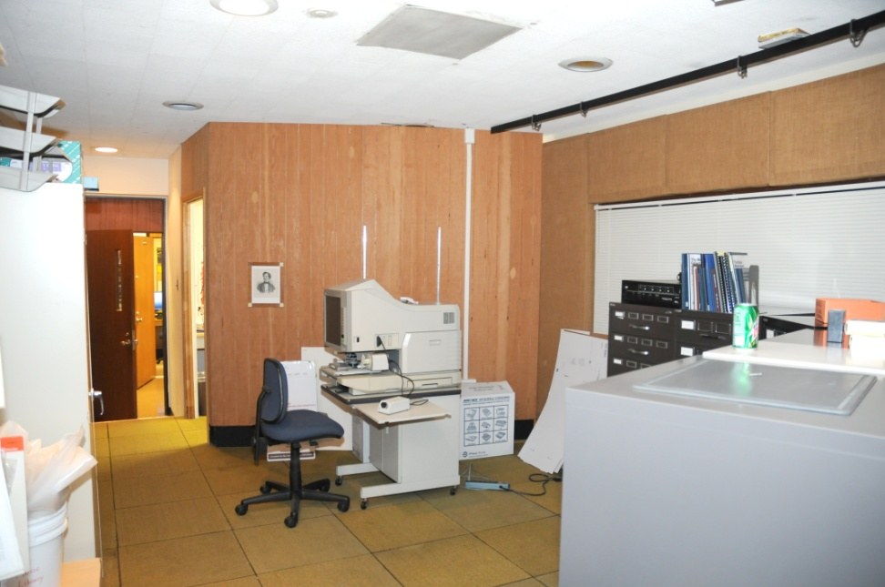
Compartmentalized Spaces in Media Center were cluttered and difficult to reconfigure
Media Center Service Desk
Microfilm Reader area in old Recording Studio

Slide 12
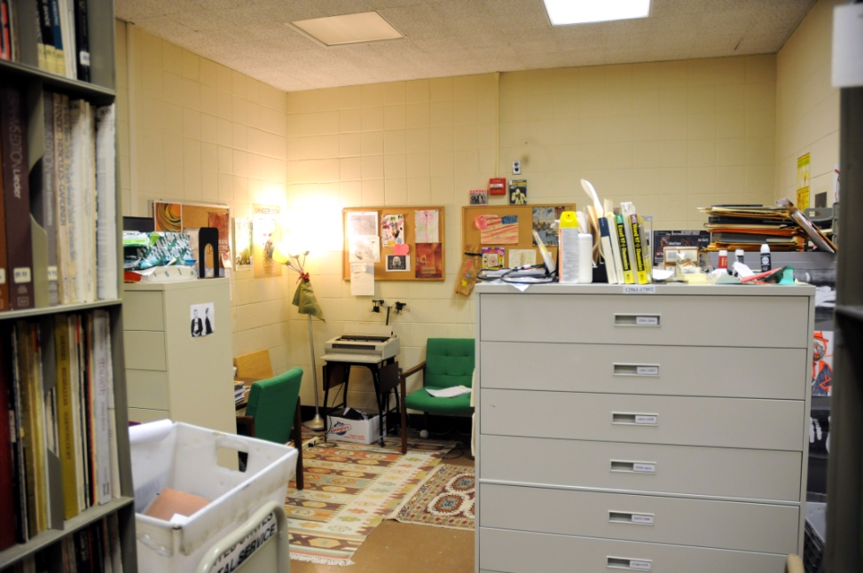
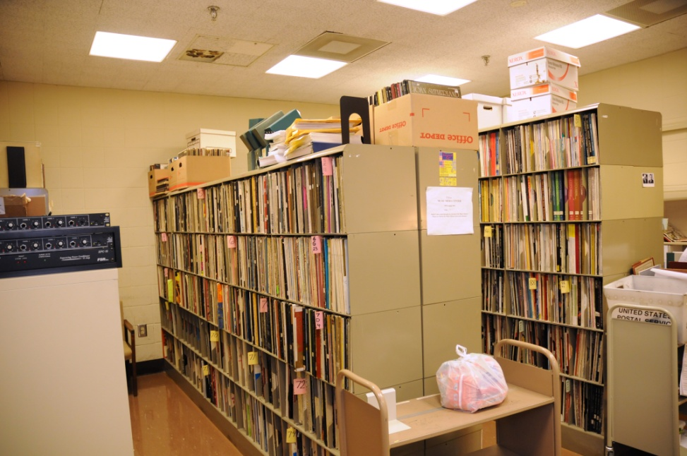
Cluttered Staff Space in Media Center Adjoining Uncataloged, Underused LP Collection
Staff Space in Media Center
Uncataloged LP Collection

Slide 13
Perfect Storm Scenario

Slide 14
Background to Renovation
Impetus for renovation had been a long time in the making and was propelled forward by several factors
Biddle Music Building built in 1974 before graduate programs in musicology and composition or the major in music—only 3500 square feet
Music Media Center added in 1989 with 1500 square feet
The collection grew rapidly, keeping pace with development of department. Stacks added and user spaces shrink

Slide 15
Renovation Planning
1992: Music Department identifies Music Library renovation as a critical priority
1993: Music Library/Recital Hall addition explored, but plan is not realized
2006: Music Department committee investigates renovation options

Slide 16
Factors Leading to Renovation Approval
Duke arts initiative raises profile of the arts at Duke
Departmental dissatisfaction reaches a tipping point
University receptive to renovation proposals
Music Department receives funding to address building issues
Plans for Baldwin Auditorium renovation develop
Time is right for the Music Library renovation, which garners financial support from Provost

Slide 17
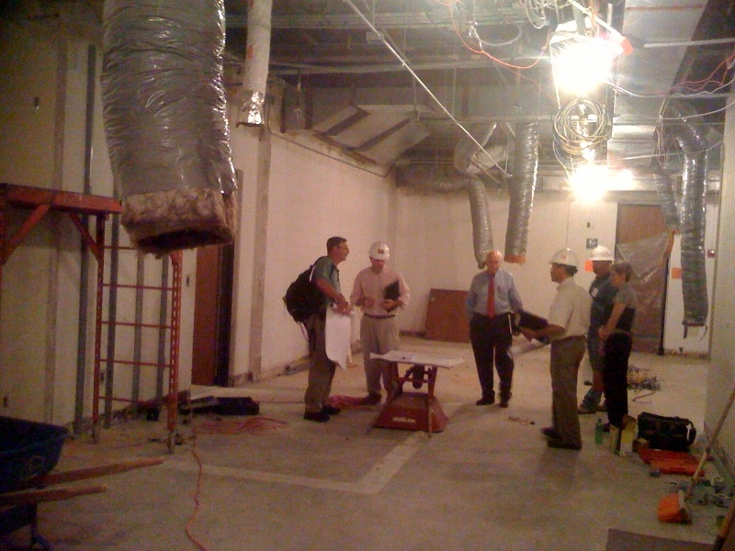
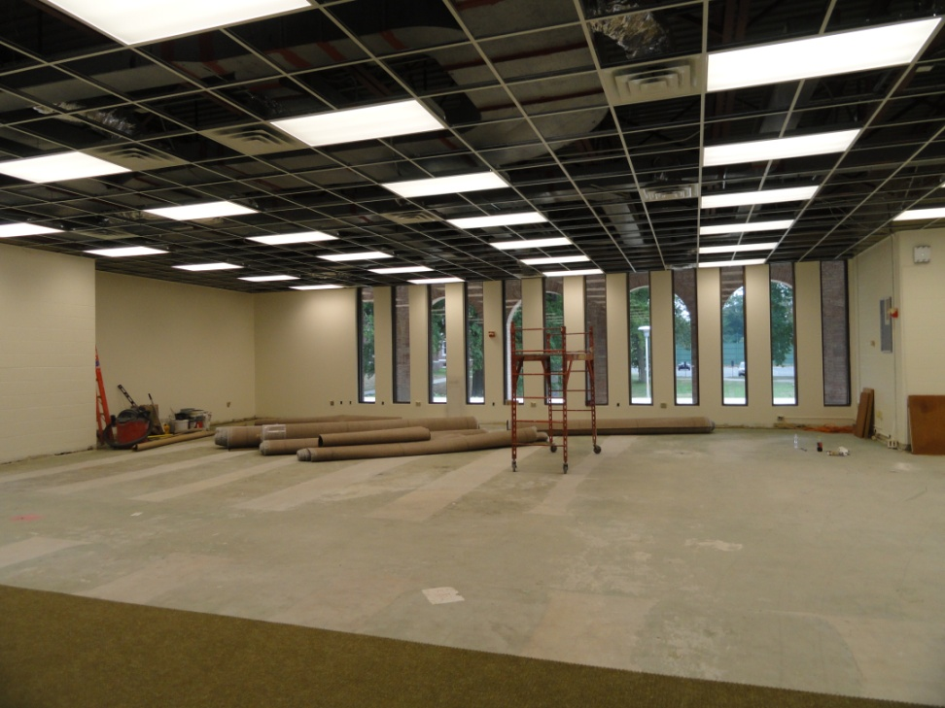
Renovation
Renovation of Main Floor
Renovation of Lower Floor
Renovation of Main Floor

Slide 18
Renovation Themes
Collaboration with Music Department

Slide 19
Support from Music Department
  Branch location offered ideal opportunity to involve core users to try to identify and broadly address departmental needs in planning process
  Vocal about the critical need for renovation of the space as well as the continued importance of a branch library
  Partnership in planning the renovation—formed a committee of music department representatives

Slide 20
Departmental Planning Committee
  Formed a planning committee in October consisting of 2 librarians and 6 Music Department representatives
  Committee willing to dedicate their time to frequent planning meetings well ahead of approval of renovation
  Reviewed architectural plans to make a recommendation about how to connect the two floors
  Identified departmental needs for library and polled their constituencies

Slide 21
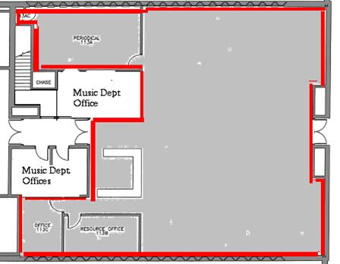
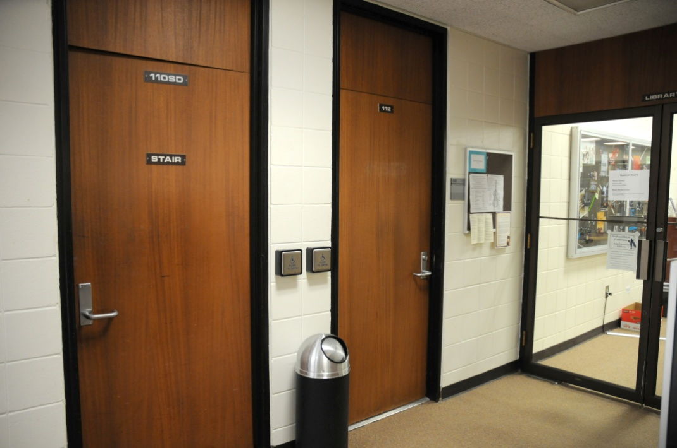
  Connect the library’s two floors in the most economical and direct way by demolishing walls of departmental office to connect library to staircase

Slide 22
Renovation Priorities
The committee formulated recommendations for reconfiguring the space in connection with departmental needs
  Open up space on the main floor for users
  Restore the Seminar Room to its original purpose
  Critical need for compact shelving in the renovation
  Return scores from offsite storage

Slide 23
Renovation Themes
DIY Renovation

Slide 24
DIY Design
Modest scale of renovation gave us considerable autonomy in design of space and selection of furnishings
Could customize design based on the needs and preferences of our users and maximize use of our small space
Plan a variety of different study zones
Design multi-purpose spaces
Take maximum advantage of floor-to-ceiling windows by placing user spaces next to windows
Decrease footprint of shelving, equipment, and furnishings to open up space

Slide 25
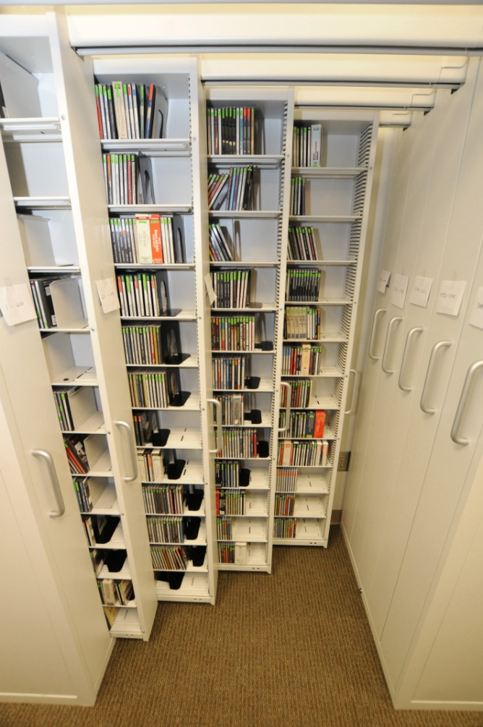
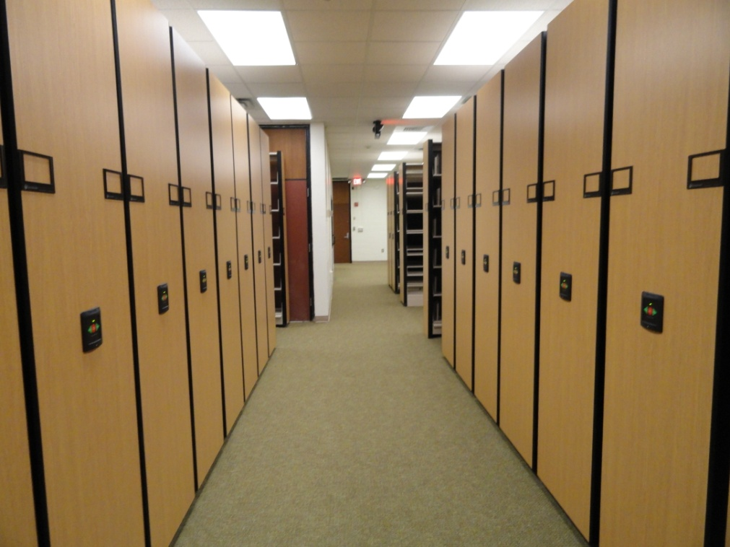
Space Savers
Compact Shelving
Gemtrac CD Shelving

Slide 26
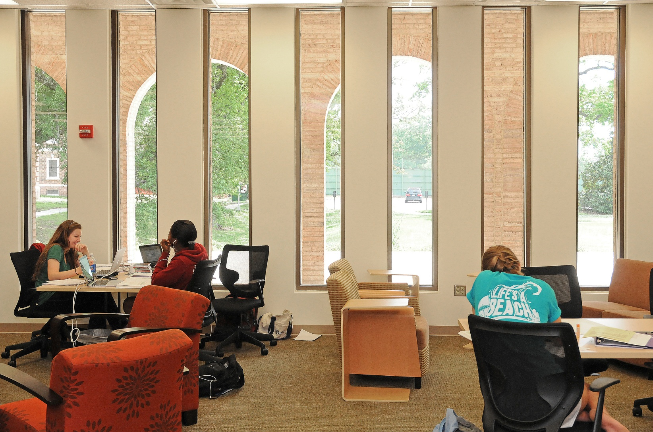
Roomy Seating Area on Main Floor

Slide 27
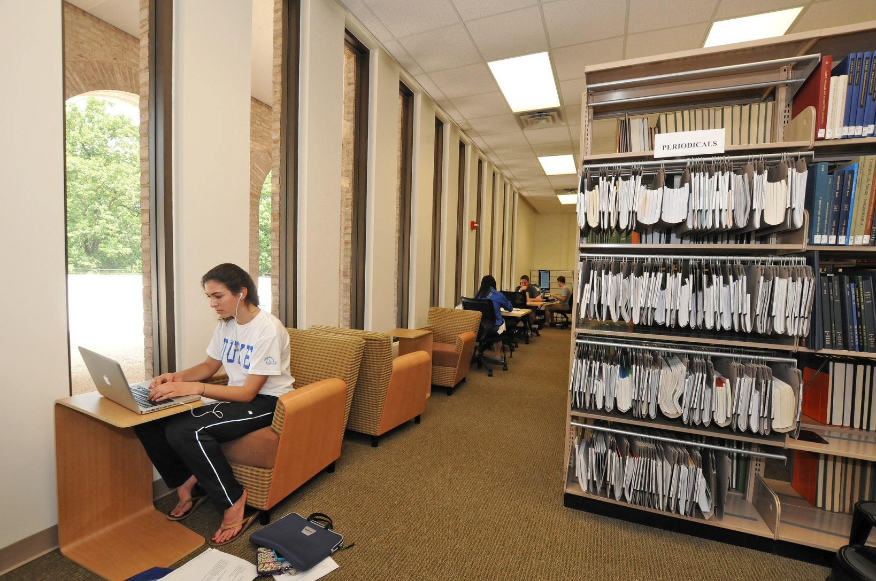
Study Nooks Near Windows

Slide 28
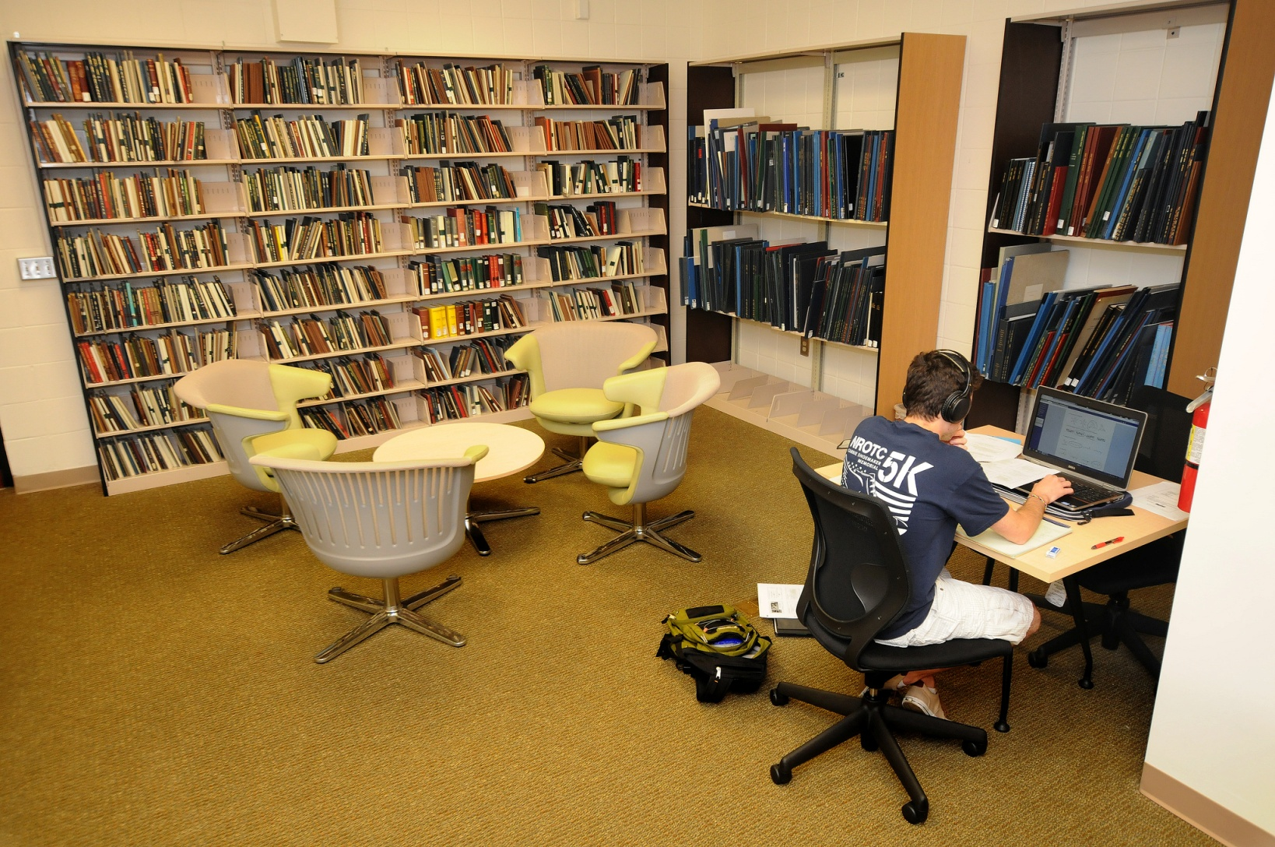
Quiet Study Area Downstairs

Slide 29
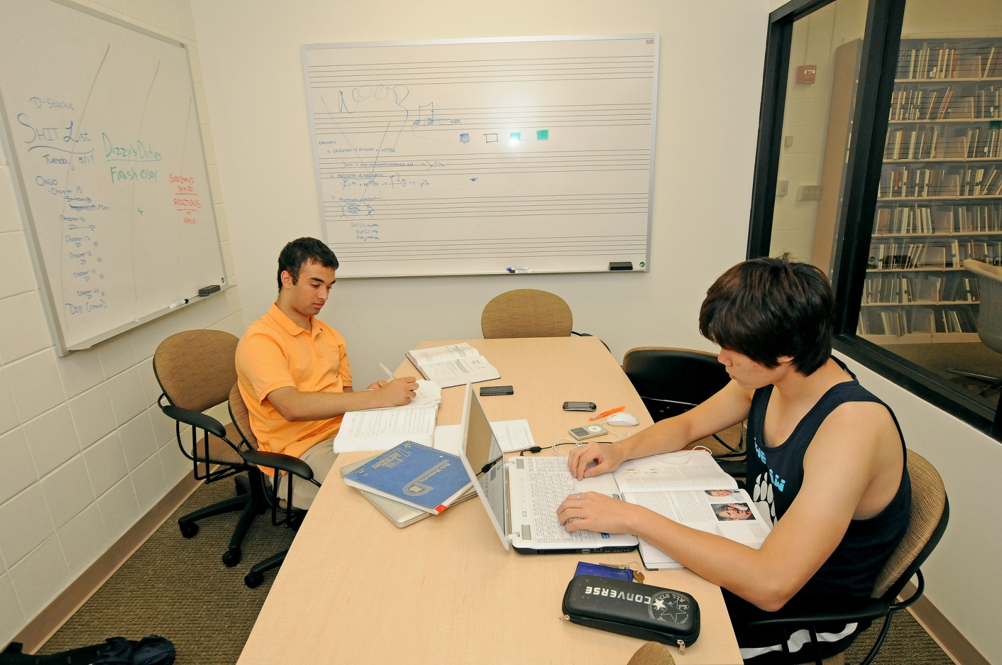
Group Study Room Downstairs

Slide 30
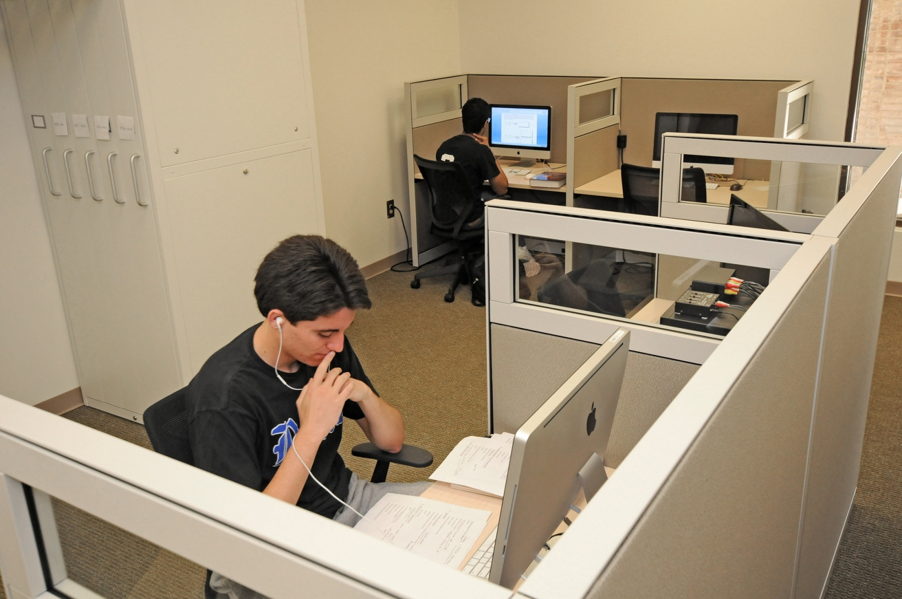
Multi-Purpose Media Carrels

Slide 31
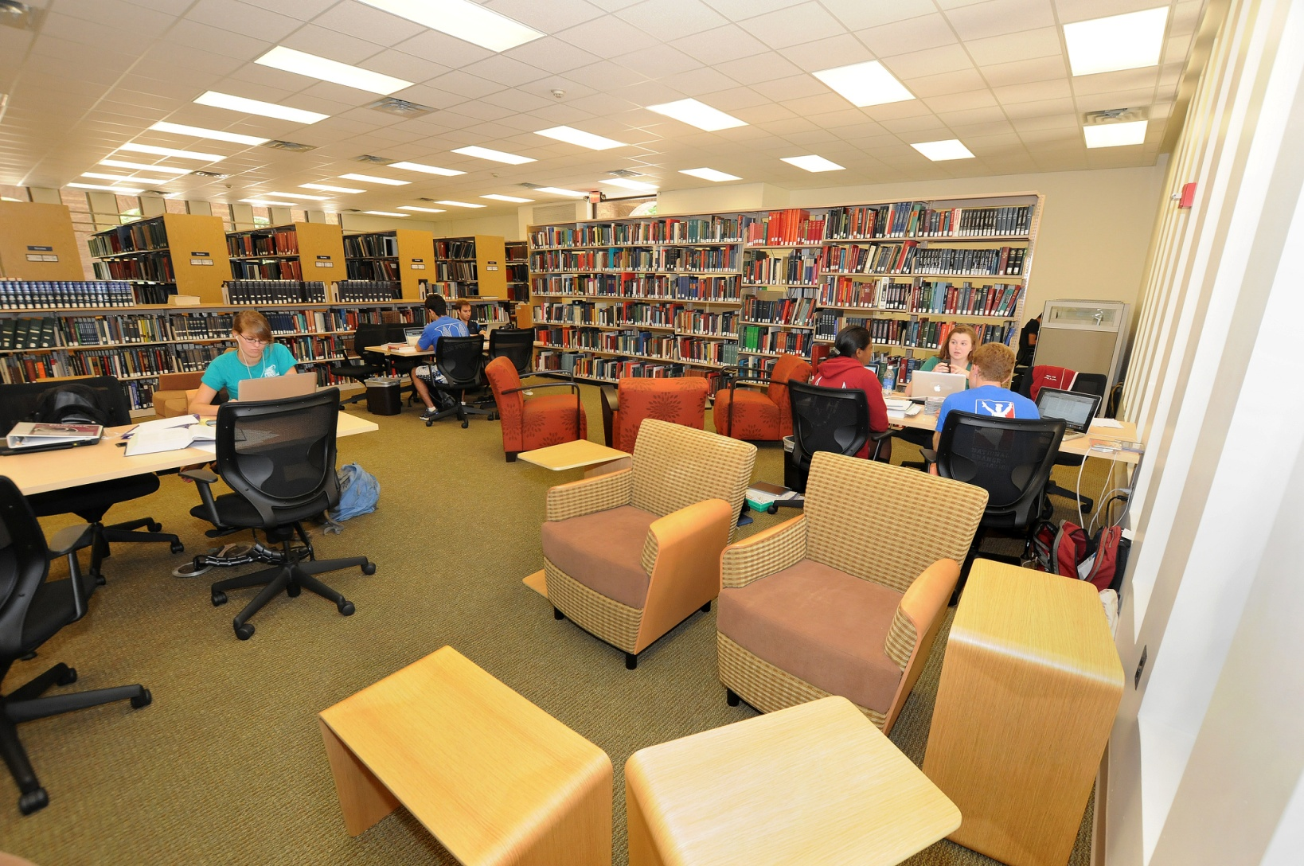
“Right Fit” Furniture

Slide 32
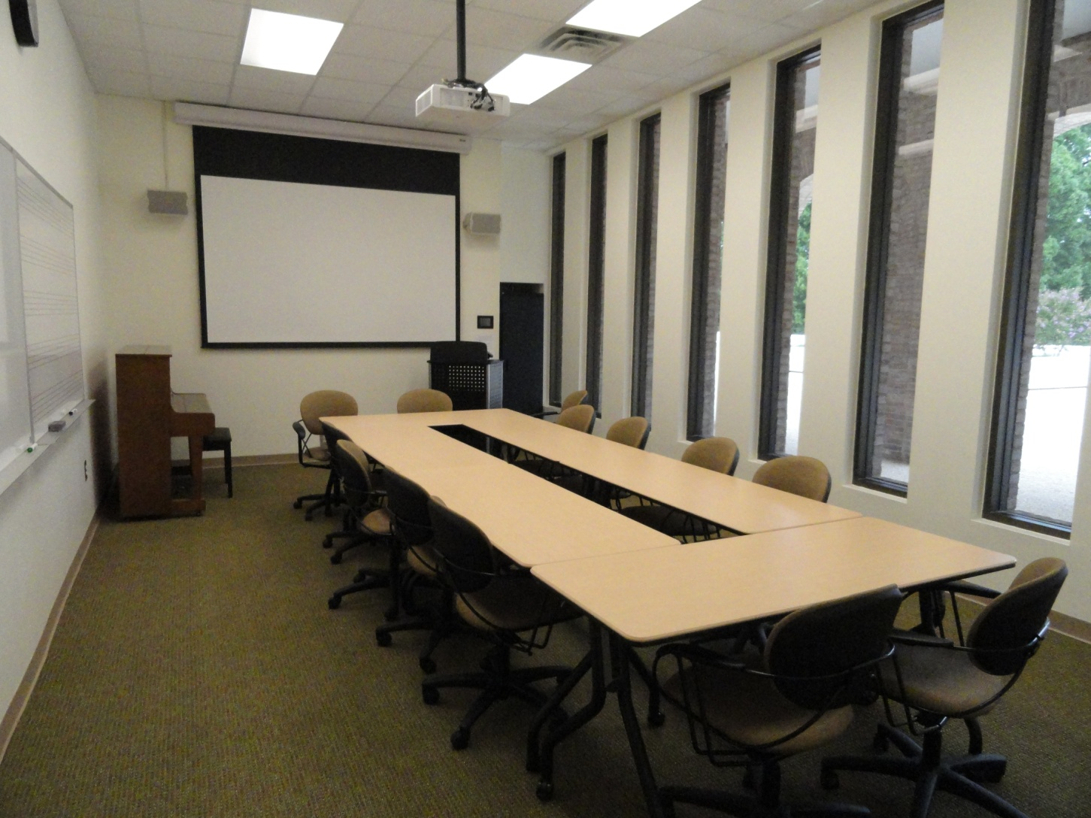
Seminar Room
Bright and Comfortable Multi-Purpose Space

Slide 33
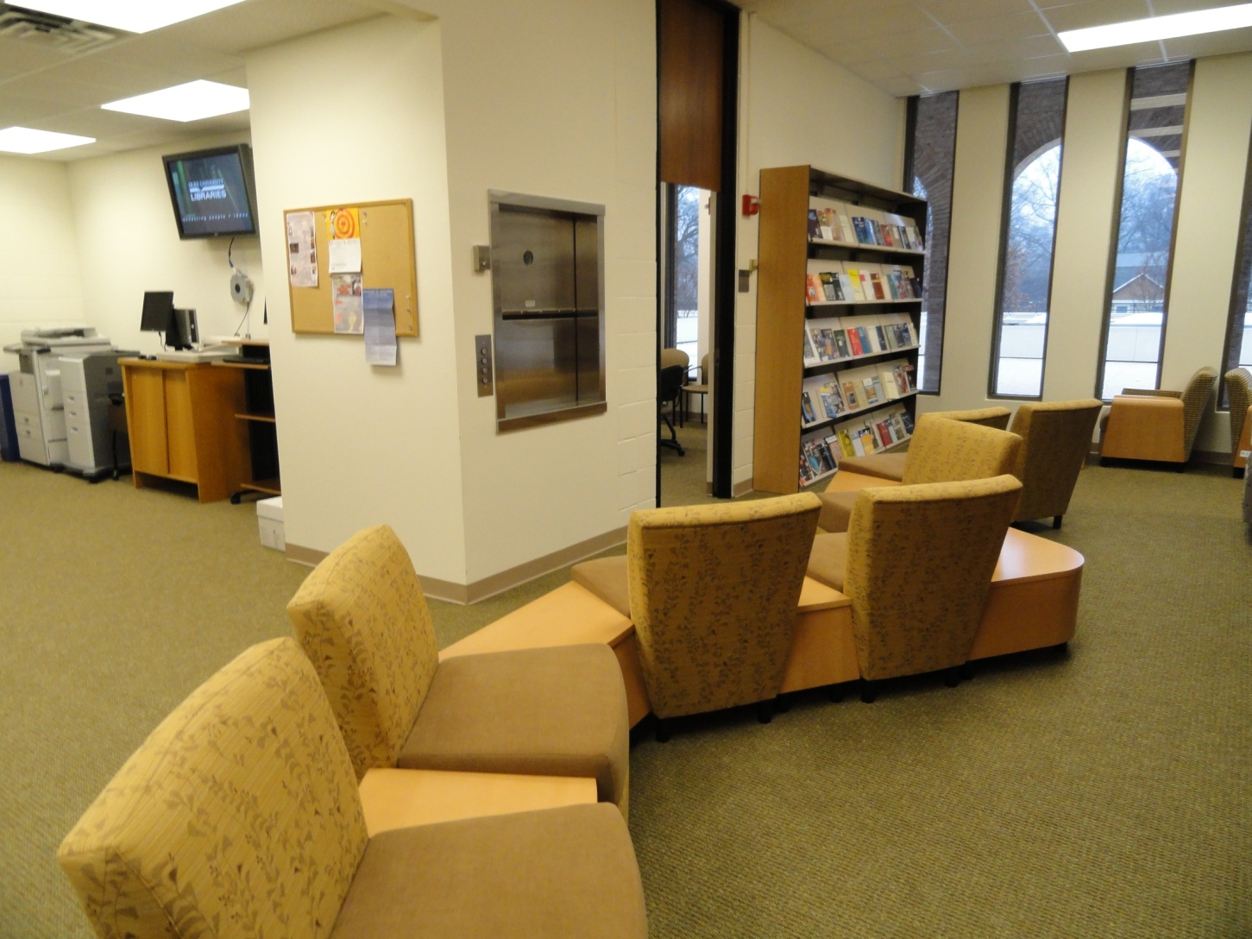
Seating Area in Front of
Seminar Room and New Title Shelves

Slide 34
Renovation Themes
Surprises

Slide 35
Renovation Surprises
Compromises as important as decisions
“In the red” before construction started and had to cut back on a variety of design features to make up shortfall
Unanticipated difficulties in drilling through solid floors and around ductwork meant that media stations were not ready until several weeks after opening
Furniture selection was a process fraught with difficulties
Good surprise: Funding left at end for additional purchases

Slide 36

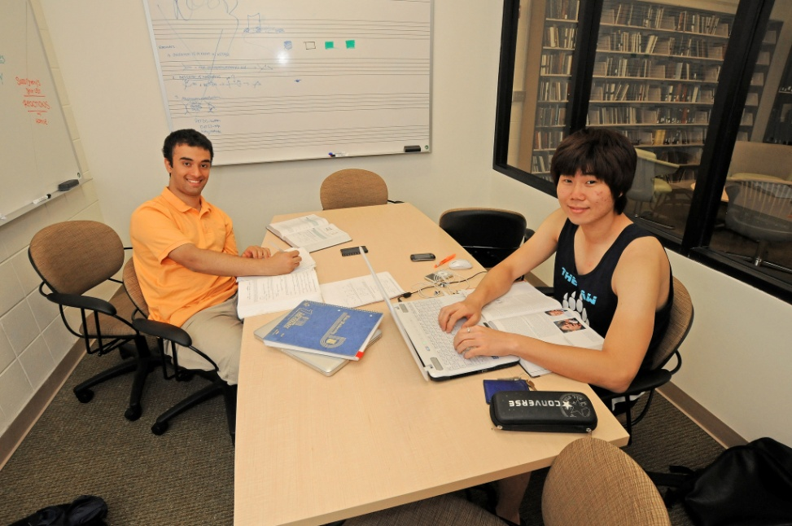
Transformed Spaces
Cluttered Office Space
New Study Spaces

Slide 37


Transformed Spaces
Former Periodicals Room
New Seminar Room

Slide 38
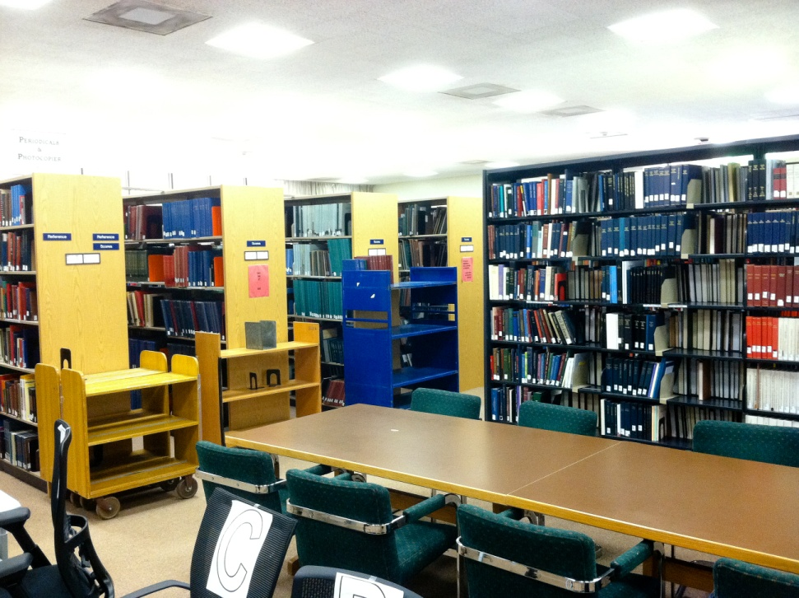
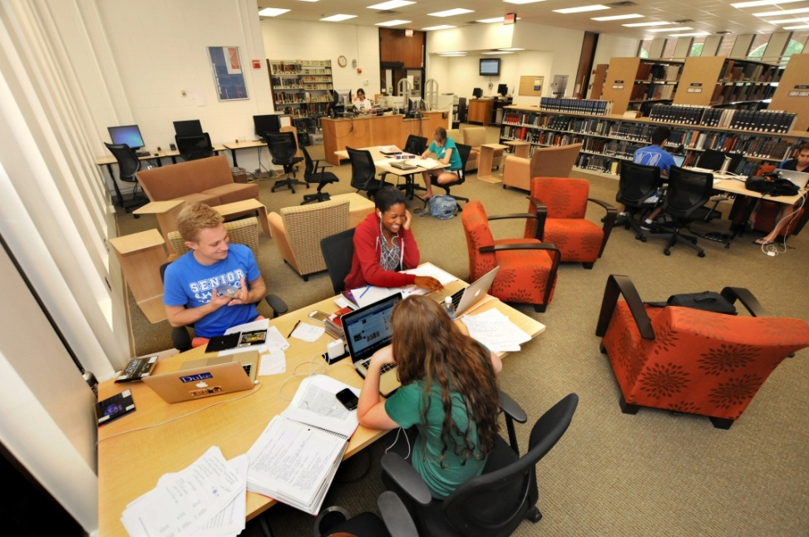
Transformed Spaces
Cramped study area
Bright, spacious new study area

Slide 39
Results of Renovation
Renovation has transformed our spaces and led to dramatic increase in number of people using the library
Increased interaction between Music Department and library, especially in usage of Seminar Room space
Increased shelving capacity has allowed us to begin bringing back thousands of scores from offsite storage
More dynamic, multi-purpose space to serve a broad range of needs, making the Music Library a destination

Slide 40
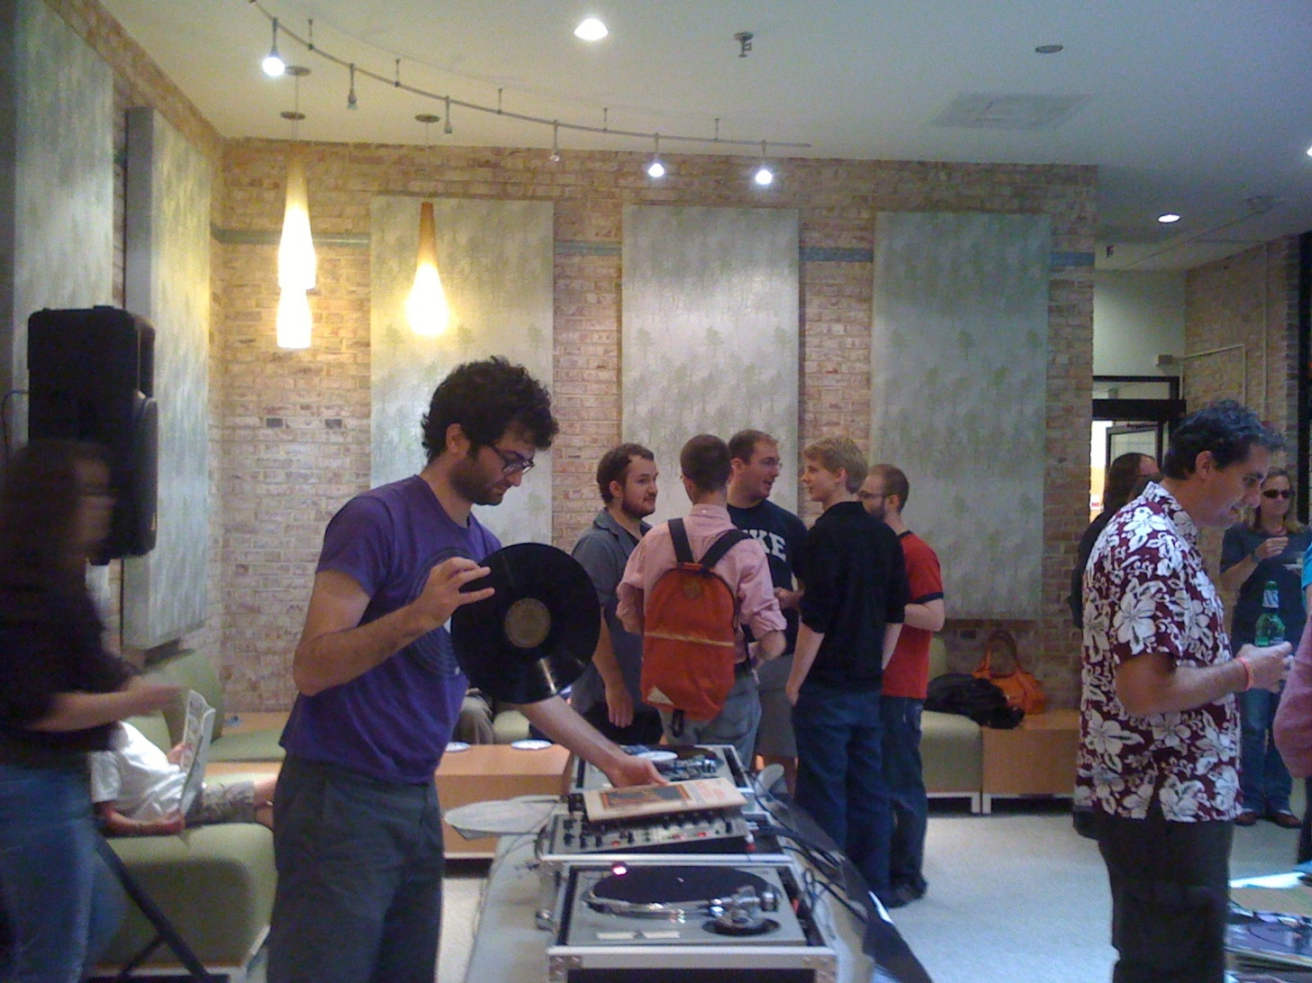
Vintage Vinyl Party

